Slide 1


PREDICT THE AMOUNT OF WATER
Supervisor :
M.Hrimech Hamid.
Presented by :
El Kabbach Chaimaa.
Zayoudi Abderrahmane.

Slide 2

Outline
Introduction
Data preprocessing
00
03
01
Problem
04
Conclusion
Feature engineering & model
Exploratory data analytics
02
05

Slide 3
Introduction
Notes:
Water is an indispensable resource for human and economical welfare, and modern society depends on complex, interconnected infrastructures to provide safe water to consumers. Given this complexity, efficient numerical techniques are needed to support optimal control and management of water distribution systems.

Slide 4
01
Problem
Notes:
The Acea Group is one of the largest Italian multiutility operators in the water services sector supplying 9 million inhabitants. It organized a competition on Kaggle to get help in predicting the water level in various types of water bodies over different seasons of the year. It is crucial for a water supply company to forecast the water level in a waterbody (water spring, lake, river, or aquifer) to handle daily consumption. It can become tedious in scenarios like during fall and winter, water bodies are refilled, but during spring and summer, they start to drain. To help preserve the health of these water bodies it is important to predict the most efficient water availability, in terms of level and water flow for each day of the year.

Slide 5
Challenge
The Acea Group provides data for 4 types of water bodies, namely, water spring, lake, river, and aquifer, to predict water availability, the reality is that each waterbody has such unique characteristics that their attributes are not linked to each other. This problem uses datasets that are completely independent of each other. As each waterbody is different from the other, the related features are also different.
1

Slide 6
Data Collection and Description
Aquifers
Lake
Water Spring
River
Auser
Bilancino
Amiata
Arno
Madonna di
Canneto
Petrignano
Doganella
Lupa
Luco
2
Notes:
we will use nine different datasets, completely independent and not linked to each other. Each dataset can represent a different kind of waterbody. As each waterbody is different from the other, the related features as well are different from each other. So, if for instance we consider a water spring we notice that its features are different from the lake’s one. This is correct and reflects the behavior and characteristics of each waterbody. The Acea Group deals with four different types of waterbodies: water spring (for which three datasets are provided), lake (for which a dataset is provided), river (for which a dataset is provided) and aquifers (for which four datasets are provided).

Slide 7
Data Collection and Description
INPUT
FEATUTE TO FORECAST
Auser
Petrignano
Doganella
Luco
Data preprocessing
Feature engineering
EDA
AQUIFER
Depth to Grounwater
AQUIFER
Amiata
Madonna di Canneto
Lupa
WATER SPRING
Flow Rate
WATER SPRING
LAKE
Bilancino
Identification of a predictive Model for each waterbody
LAKE
Hydrometry (Lake level)
Flow Rate
RIVER
Arno
RIVER
Hydrometry (River level)
3

Slide 8
02
Exploratory data analytics
Notes:
The Acea Group is one of the largest Italian multiutility operators in the water services sector supplying 9 million inhabitants. It organized a competition on Kaggle to get help in predicting the water level in various types of water bodies over different seasons of the year. It is crucial for a water supply company to forecast the water level in a waterbody (water spring, lake, river, or aquifer) to handle daily consumption. It can become tedious in scenarios like during fall and winter, water bodies are refilled, but during spring and summer, they start to drain. To help preserve the health of these water bodies it is important to predict the most efficient water availability, in terms of level and water flow for each day of the year.

Slide 9
Exploratory data analytics
EDA is an approach to analyzing data sets to summarize their main characteristics in easy to-understand form, often with visual graphs, without using a statistical model or having formulated a hypothesis Exploratory data analysis was promoted by John Tukey to encourage statisticians to examine visually their data sets, to formulate hypotheses that could be tested on new datasets. These visualization capabilities also allowed statisticians to identify outliers, trends and patterns in data that merit further study.
4
Notes:
we used a few graphs to do the analysis of data, then we explained each graph to explore the data, in order to understand them well, in this presentation , we will display some of them and there exploration.

Slide 10
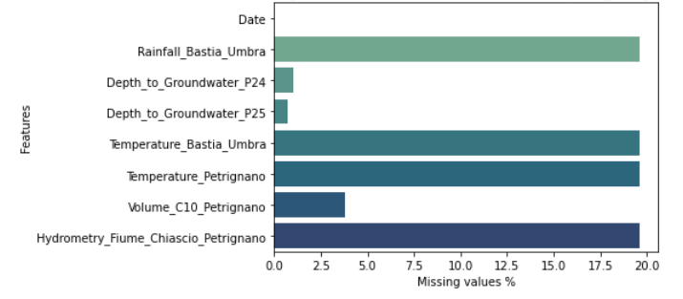
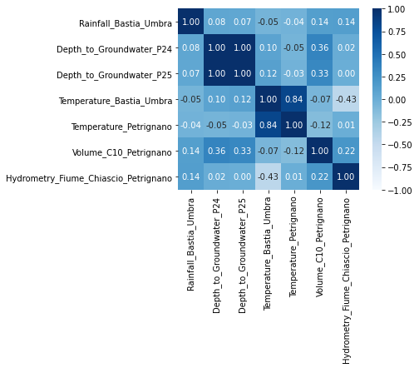
EDA – Missing & correlation in Dataset
Percentage of missing values in features in the dataset of Petrignano aquifer.
Correlation in the dataset features of Petrignano aquifer.
5
Notes:
For Aquifer Petrignago, the maximum number of missing values is in the features Rainfall_Bastia_Umbra, Temperature_Bastia_Umbra, Temperature_Petrignano and Hydrometry_Fiume_Chiascio_Petrignano with about 20% missing values and apart from the non-null features, the minimum number of missing values is in feature Depth_to_Groundwater_P24, Depth_to_Groundwater_P25 with about 1% missing values.
For Aquifer Petrignago, positively strongly correlated features are Depth_to_Groundwater_P24, Depth_to_Groundwater_P25, Temperature_Bastia_Umbra, Temperature_Petrignano and negatively correlated features are Temperature_Bastia_Umbra, Hydrometry_Fiume_Chiascio_Petrignano.

Slide 11
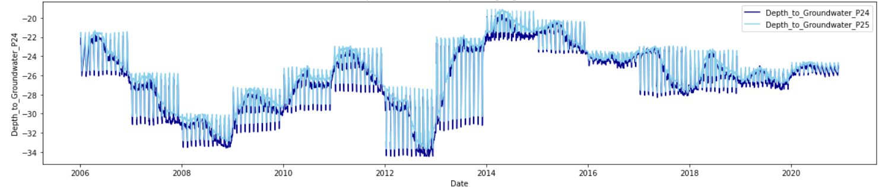
EDA - Target feature analysis
Output features for Aquifer Petrignano with Date.
6
Notes:
The Depth to Groundwater in 2006 was at -24 m in 2006 and recorded around at the same after 2020.
Maximum depth to groundwater was seen in 2013 upto -34 m.
Minimum depth to groundwater was seen in 2015 as low as -20 m.

Slide 12
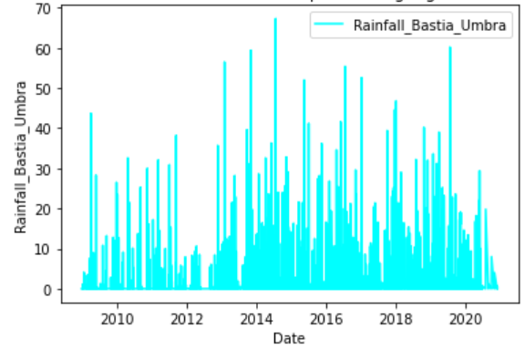
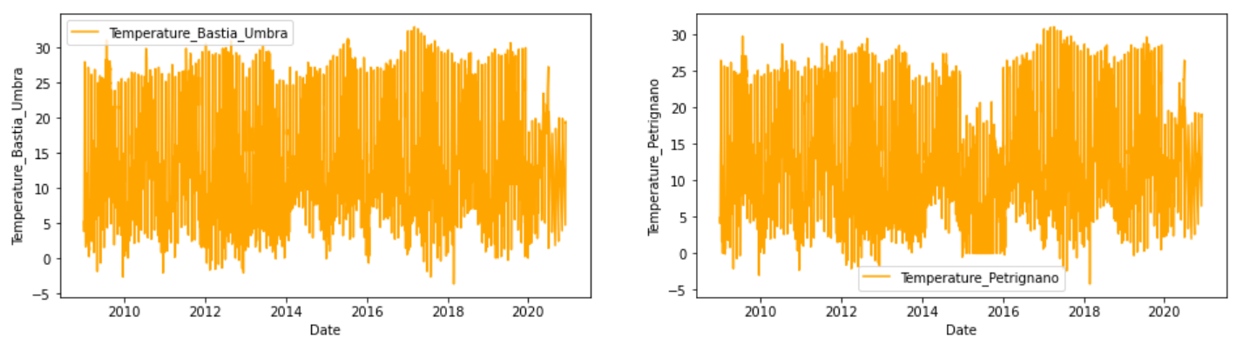
EDA - Feature analysis with date
Rainfall features in Aquifer Petrignago.
Temperature features in Aquifer Petrignano.
7
Notes:
Rainfall features in Aquifer Petrignago.
Highest rainfall was recorded in 2014 at 70 mm and lowest in 2012 at 10 mm.
Decreasing trend is observed from 2019 till 2020.
Temperature features in Aquifer Petrignano
Temp ranges from -5 to 30 degrees till 2018.
2019 to 2020 are comparatively colder from 0 till 25 degrees. Also, 2015 to 2016 have a dip in temperatures in Petrignano

Slide 13
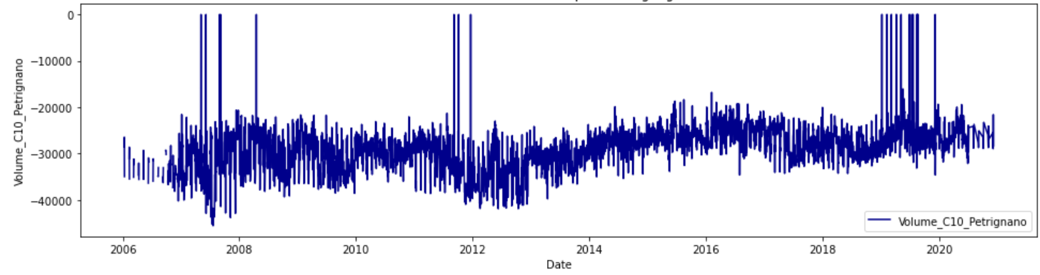
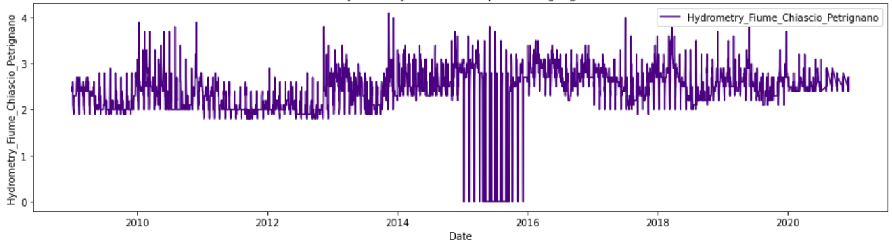
EDA - Feature analysis with date
Volume features in Aquifer Petrignago.
Hydrometry features in Aquifer Petrignago.
8
Notes:
Volume features in Aquifer Petrignago.
Volume is almost consistent over the years in the range of -3000 cubic meters.
Hydrometry features in Aquifer Petrignago.
A hydrometry of 3 m is observed at Petrignano in 2020.
All time high ranges upto 4 m occassionally.

Slide 14
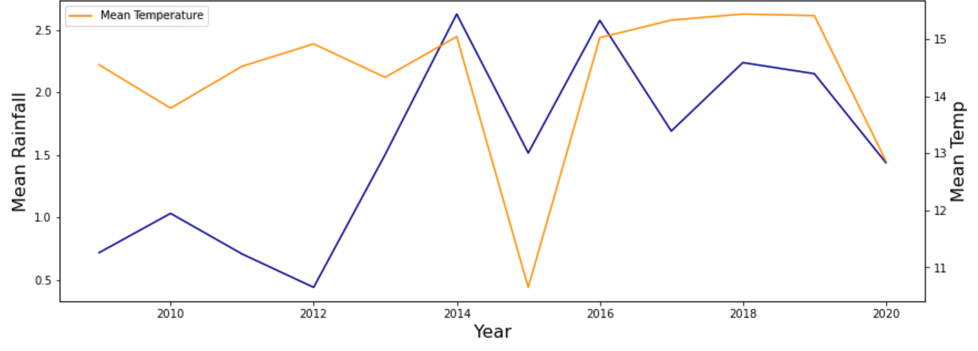
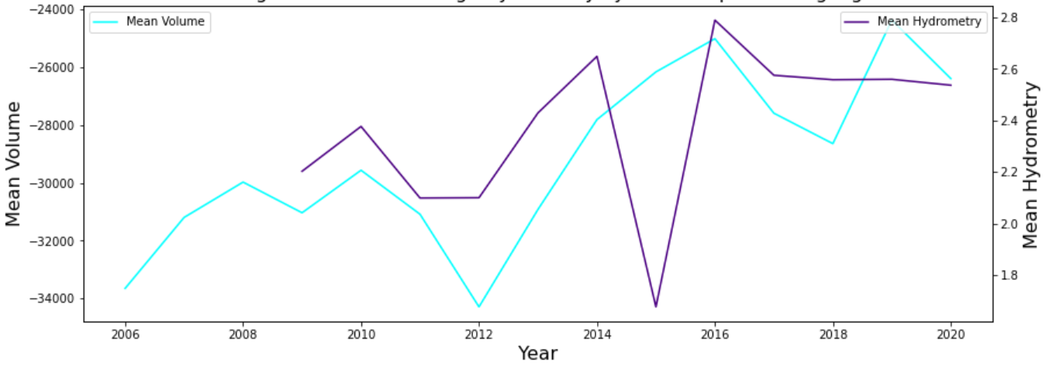
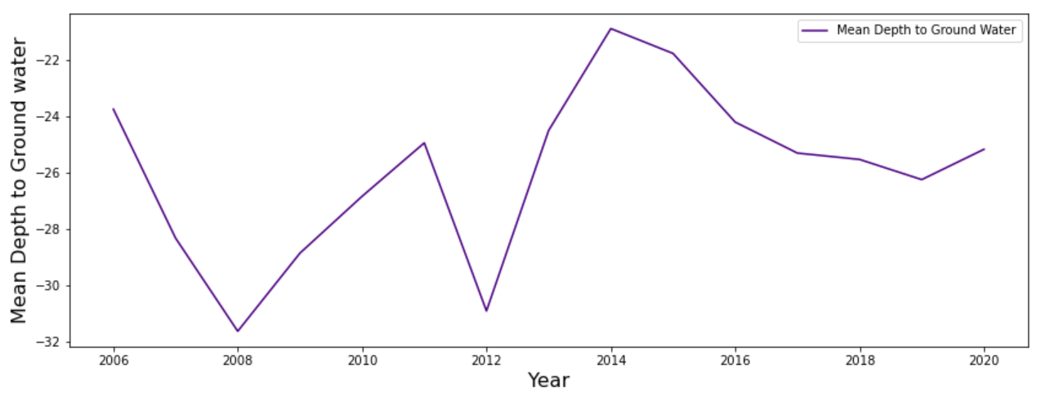
EDA - Yearly comparison of all features with target features
Rainfall and Average Temperature by Year in Aquifer Petrignago.
Average Volume and Average Hydrometry by Year in Aquifer Petrignago.
Average Depth to Groundwater by Year in Aquifer Petrignago.
9
Notes:
When mean rainfall is low and mean temp is high, when mean volume is deep and hydrometry is moderate, is when the mean depth to ground water is the highest. Like in the year 2008 and 2012, it is the deepest at -32 m.

Slide 15
03
Data preprocessing

Slide 16
Steps
Choice of Metrics
Imputation of missing value
Predicting
the target feature
10
Notes:
In this section we will process the data in order to remove the anomalies found in EDA.
So ,our major issue is the missing values in all the 9 datasets. We will preprocess in three steps:
The first one is the choice of the metric
The second is the . Imputation of missing values
And the third and last step is the prediction of target feature with Random Forest, , Linear Regression, Decision Tree and KNN, with different values of k.

Slide 17
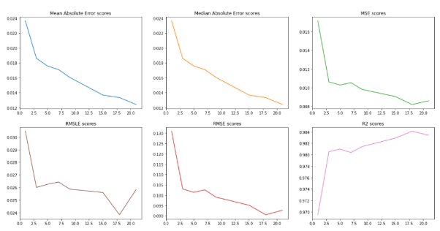
Choice of Metrics
We chose our metrics for the problem as Median Absolute Error (MAE), Root Mean Square Log Error (RMSLE) and R Squared (R²)
MAE is robust to outliers whereas RMSE is not
MAE because it’s robust to outliers whereas RMSE is not acceptable, but overestimation can be tolerated
high R² means that the correlation between observed and predicted values is high
11
Notes:
to choose the best metrics that we will work with in the following parts, we calculate Mean Absolute Error scores, Median Absolute Error scores, MSE scores, RMSE scores, RMSLE scores and R2 scores for different k value in the KNN Imputer in one of our datasets. The metrics used in this section are about the models of random forest that is depends by the K of the KNN Imputer.
The metrics chosen are Median Absolute Error (MAE), Root Mean Square Log Error (RMSLE) and R Squared (R²) :
We have chosen the MAE because it’s robust to outliers whereas RMSE is not and Using median is an extreme way of trimming extreme values.
RMSLE is used because the underestimation of the target variable is not acceptable, but overestimation can be tolerated. The RMLSE incurs a larger penalty for the underestimation of the actual value. Also, we don’t want to penalize huge differences in the predicted and the actual values when both predicted and actual values are huge numbers.
And finally, we chose the R² because ,high R² means that the correlation between observed and predicted values is high. It tells how good our regression model is as compared to a very simple model that just predicts the mean value of target from the train set as predictions.

Slide 18
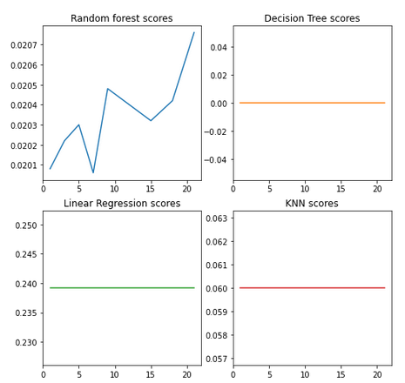
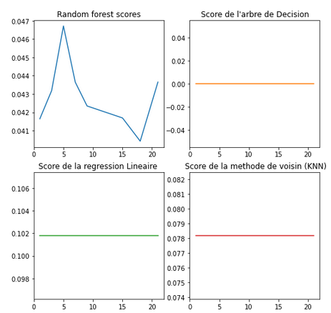
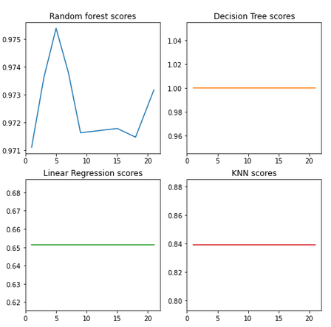
Imputation of missing value
Various models MAE performance for different k values
Various models RMSE performance for different k values
Various models R2 performance for different k values
12
Notes:
We take only the rows where target features are not null. Impute the missing values in the independent features using KNN imputation with the selected least error k value (this is done by plotting k values with our chosen metrics MAE, RMSLE, and R2 score).
Like you see here, we have 3 graphs with different metrics by different algorithms and diffrents K Values.
We remarks that the best one ise the random forest.
Notice that is an example of aquifer auser, In other case we found other algorithms are best than random forest.

Slide 19
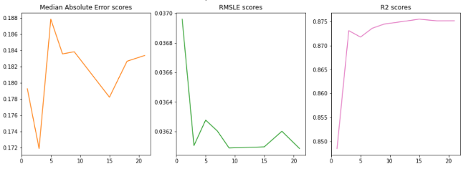
Predicting the target feature
Various metrics performance for different k values.
13
Notes:
Like we see in the previous step (different plots for model's error metrics) the best one is Random Forest model.
We can see in the figure the variation of performance for different k values, and for that example the best one is the k = 18
As conclusion we will take this k=18 and we train the model with k=18.

Slide 20
04
Feature engineering & model

Slide 21
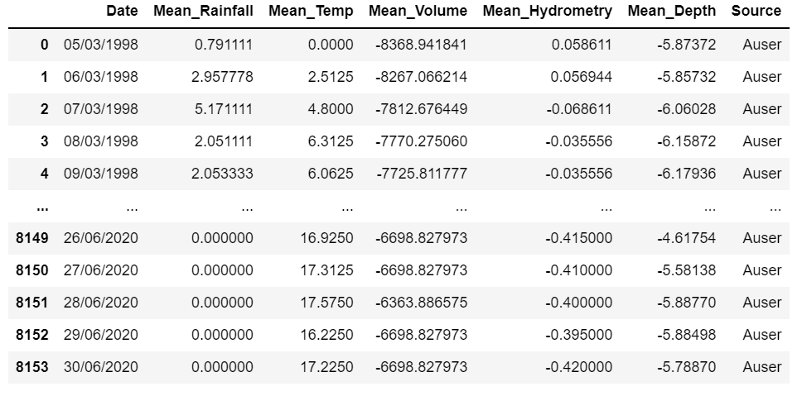
Combining the data
In this step, we have used different water bodies combined as one of each type:
Aquifer (Auser – Petrignano – Doganella - Luco)
Lake (Bilancino)
Rivers (Arno)
Springs (Amiata - Madonna di Canneto - Lupa)
We have taken average based on different time durations: Daily, Weekly, Monthly and Yearly.
15

Slide 22
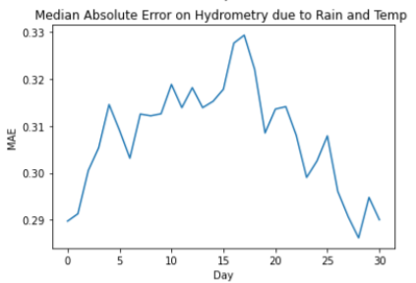
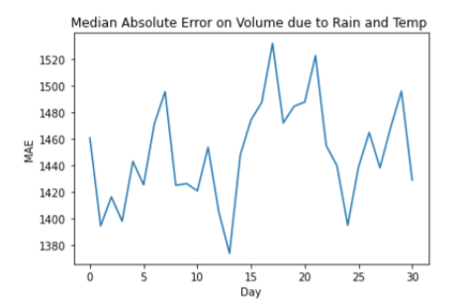
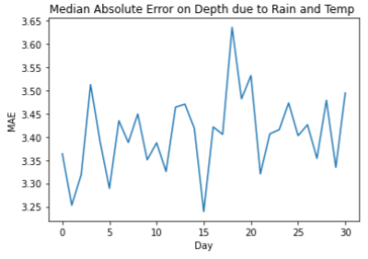
Shift fill
In this step, we take the average, then we tried to out the median absolute trends in each of these duration models when the variables are shifted by durations (Week, Month, Year, Days).
16
Notes:
We started by daily average, then we combined the 4 aquifer datasets to apply the shifts to the combined data, for example, in the case that we have daily, we shifted the data by combination of 1 to 31 days, our goal is the least error for the model tha we used by the random forest, i.e., that number of days shows the real effect of rainfall and temperature.
We observed that the least error i.e., the actual effect of rainfall and temperature is observed when the values are recorded after 26 days. So, we will shift the values by 26 days (the same method to the other durations). As a conclusion of observing best results at 26 days, 8 weeks, and 2 months, let’s have the final aquifers dataset by shifting the values by 56 days (8 weeks or 2 months) backward.

Slide 23
Models
We used several algorithms to find the best model, the algorithms used are as follows:
KNN
Multiple Linear Regression
Random Forest
SGDRegression
Decision Tree Regressor
XGBoost Regressor
AdaBoost Regressor
MLP Regressor
17

Slide 24
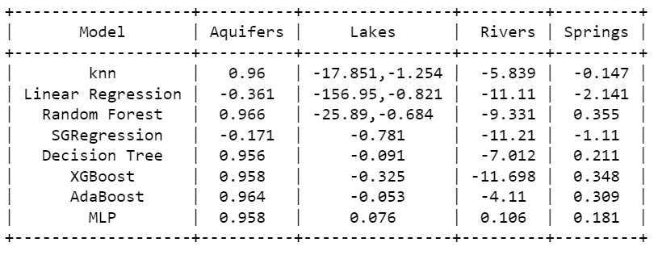
Model’s Comparaison
We compare the different models with the metric R2 score.
18

Slide 25
Conclusion
Notes:
Water is an indispensable resource for human and economical welfare, and modern society depends on complex, interconnected infrastructures to provide safe water to consumers. Given this complexity, efficient numerical techniques are needed to support optimal control and management of water distribution systems.

